Slide 1




Integrated Disability Evaluation System (IDES)
Health Policy & Services
Office of the Surgeon General
1 March 2011
UNCLASSIFIED

Slide 2
BRIEFING OUTLINE
PURPOSE: To provide an overview of the IDES
Two Distinct Systems
DES Pilot Overview & Background
DES Pilot reform / chronology
Concept/Scope
DES Pilot Policy
DES Pilot Timeline
Summary
Questions

Slide 3
Two Distinct Systems
DoD (Law and Policy)
VA (Law and Policy)
The DES shall be the mechanism for determining return to duty, separation, or retirement of Service members because of disability in accordance with chapter 61 of 10 USC.
The DES shall consist of five elements: medical evaluation; disability evaluation, including appellate review; counseling; specific case-management; and final disposition. The medical and disability evaluations shall be executed by Medical Evaluation Boards (MEBs) and Physical Evaluation Boards (PEBs) for each respective Military Department.
  In accordance with 38 USC, Department of Veterans Affairs conducts an evaluation for physical disability and assigns a rating of disability when appropriate in accordance with the schedule for rating disabilities utilized by the Secretary of Veterans Affairs (VASRD).
Slide 3 of 20

Slide 4
Where We Came From
For years, DoD and VA have worked to improve care for disabled Service members and Veterans
But increased media attention from…
“Soldiers Face Neglect, Frustration at Army’s Top Medical Facility”
Washington Post, February 18, 2007
Result: “Apart from the war itself, we have no higher priority!”
Secretary Gates

Slide 5

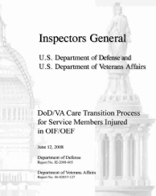
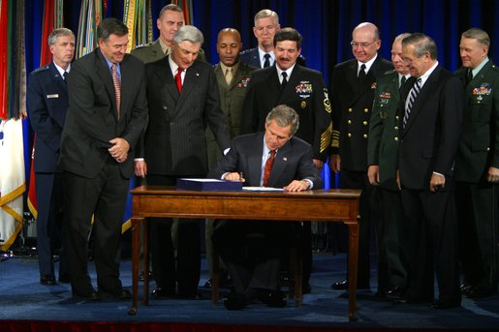




Hundreds of Recommendations, Mandates and statutes…
After World War II, Congress authorized the Hook Commission to assess military compensation. The commission's findings led to the Compensation Act of 1949. The act became the first major legislation in 40 years to dramatically change the military compensation system.
The disability retirement system in effect today remains basically unchanged from that adopted in 1949
2008
National Defense
Authorization Act
…Launching of the DES Pilot/IDES To Address
Simplify for the Service Member
Reduce Processing Time
Improve Consistency of Ratings/Increase Transparency
Maintain Appellate Procedures
Provide Effective Transition From DOD to VA Care

Slide 6
IDES Background
Background
To honor our wounded, ill, and injured Service members, veterans, and their family member(s), the Department of Defense (DoD) and Department of Veteran’s Affairs (VA) are moving to a process that streamlines the Disability Evaluation System (DES) by closely aligning resources to provide a single comprehensive physical coupled with a single-sourced disability rating.

Slide 7
IDES Concept/Scope
Concept
The IDES features a single set of disability medical examinations appropriate for determining both fitness and disability and a single set of disability ratings provided by VA. Although the IDES includes disability medical examinations, IDES processes are administrative in nature and are independent of clinical care and treatment.
Scope
The IDES scope includes all disability examinations and all administrative activities associated with IDES case management from the point of referral by an IDES trained provider to the point of return to duty or receipt of VA’s benefits decision letter, including the management of Service members who are temporarily retired for disability through the IDES.

Slide 8
Integrated Solutions
Single Comprehensive Medical Examination…consistency:
  Service member will undergo one evaluation—conducted by VA certified physicians—as opposed to two separate evaluations
Single-Sourced Disability Rating…consistency:
  Service member will receive disability ratings determined by VA disability evaluators—as opposed to two separate disability ratings
  Under 10 USC 113, Service Secretaries are directed to use VA rating of unfitting conditions vs. rating these conditions within the Department
Faster Disability Processing…transparency:
  DoD will use VA-certified medical exam and disability rating to determine Service member’s fitness for duty and military and VA benefit eligibility while still on active duty
  Service member will transfer to benefits and compensation, available through VA, as soon as possible upon disability separation or retirement

Slide 9
DES Reform Chronology
April 2006 – GAO Report on the Integrated Disability Evaluation System
Fall 2006 – DES Business Process Review facilitated by P&R IM
March 2007 – Senior Oversight Committee (SOC) chartered and Lines of Action initiated
May 2007 – Published P&R DES Report and strengthened DES Policy on reporting & timeliness
August 2007 – Tested alternative DES processes in joint DoD-VA exercise
November 2007 – Initiated IDES in National Capital Region (NCR)
March 2008 – Published initial IDES report to Congress and first policy on 2008 National Defense Authorization Act (NDAA)
October 2008 – Published second policy on 2008 NDAA, expanded IDES to 18 locations
November 2008 – Published interim IDES report to Congress
September 2009 – SOC approved expansion of the IDES to 6 additional locations (Currently at 16 Army MTFs)
Notes:
It is important to note that the Departments were already engaged in evaluating and improving the DES process prior to the series of articles published by the Washington Post in February 2007.
The IDES was initiated in November 2007 to provide a more streamlined approach to evaluating our Service members. As the IDES has grown in participants and locations, the Departments have updated policy and published procedural guidance to better regulate the process and address observations and needs of participants, providers, and stakeholders. Since implementing the IDES, the Departments have sought to ensure that guidance from senior leadership is reflected in the day-to-day procedures of the IDES.
In addition, the Departments have provided two formal reports to Congress that evaluated the status, overall practicality, impact, and effectiveness of the IDES.
Following a thorough review of the IDES at 3 National Capital Region (NCR) locations, the SOC approved in August 2008, expansion of the IDES to 18 military treatment facilities outside the NCR, and, on September 17, 2009, expansion to 6 more locations. This will bring the total number of IDES locations to twenty-seven by March 31, 2010.

Slide 10
IDES Policy
DES Pilot Policy can be found on the Veteran Tracking Application (VTA) DES Pilot homepage
DoDD 1332.18, "Separation or Retirement for Physical Disability," dated November 4, 1996
DoDI 1332.38, "Physical Disability Evaluation," dated July 10, 2006
Policy and Procedural Update for the Disability Evaluation System (DES) Pilot Program, dated December 11, 2008
Cross-Service Support, and Service Organization Role at DES Pilot Locations, dated March 29, 2010

Slide 11
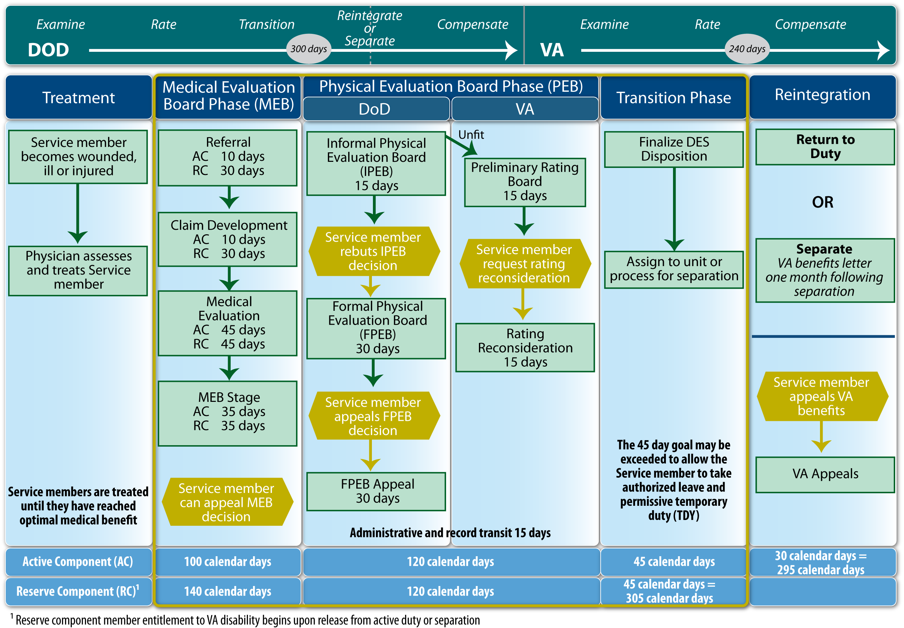

Legacy DES and IDES Process Comparison
Legacy DES
540 Days
Service members are referred within 1 year of being diagnosed with a medical condition that does not appear to meet medical retention standards.
MRDP
IDES
295 Days
Notes:
The top portion of this chart depicts the Legacy DES process wherein an individual completes the DoD disability process prior to engaging with the VA. The average case under the Legacy DES takes 540 days from referral for a Veteran who was discharged for disability to receive their VA benefits decision.
The IDES eliminates duplicative disability examinations and ratings. Once a DoD physician refers a Service member into the disability system, DoD and VA case workers counsel the Service member and help them complete a disability claim and complete disability exams. A board of DoD physicians then determines whether the Service member meets medical retention standards. If the member does not meet medical retention standards established by their Service, the case is sent to the Military Department’s Physical Evaluation Board.
An Informal Physical Evaluation Board then reviews the case and determines fitness for duty. If the Service member is not fit for duty, the VA Disability Rating Activity Site (DRAS) determines disability ratings. The Service member may request that a Formal Physical Evaluation Board re-evaluate their fitness or for the VA to reconsider their ratings for unfitting conditions. The Service member may also appeal the findings of the Formal Board to the Military Secretary. When the Military Secretary establishes a final disposition, the Service member either returns to duty or transitions to Veteran status. One of the primary advantages of the IDES for Service members is that the early involvement of the VA enables them to provide the new Veteran disability compensation about one month after discharge.
The timelines at the bottom of the chart identify the IDES goals for average process durations. Reservists are provided more time in the Medical Evaluation Board phase to consolidate the entire medical record. For Reservists the IDES process ends when the Service member is released from active duty, whereas the Active Component timeline incorporates transition and VA benefits periods, accounting for the time necessary for the Service member to prepare for re-entry to civilian status and for the VA to receive proof of Veteran status (DD Form 214) and initiate delivery of disability compensation and benefits.

Slide 12
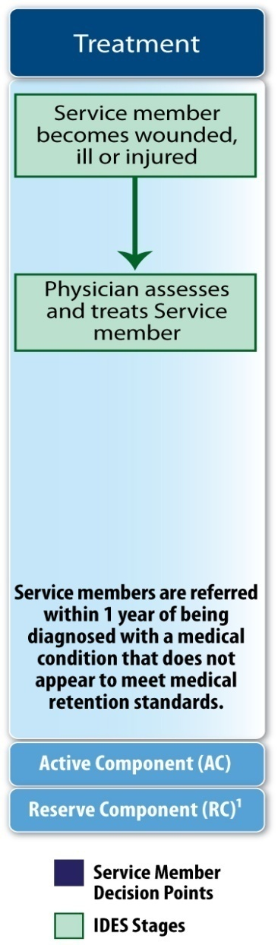
Treatment Phase
Process:
The Service member (SM) presents to Military Treatment Facility (MTF)
The MTF Medical Care Provider treats SM
When diagnosing a SM with an unfitting condition, the MTF Medical Care Provider refers a SM to the Medical Evaluation Board (MEB) using the joint DoD/VA Integrated Disability Evaluation Referral Form
*All Soldiers reaching MRDP referred to a Medical Evaluation Board (MEB) on or after the implementation date of a DES site will be enrolled in IDES

Slide 13
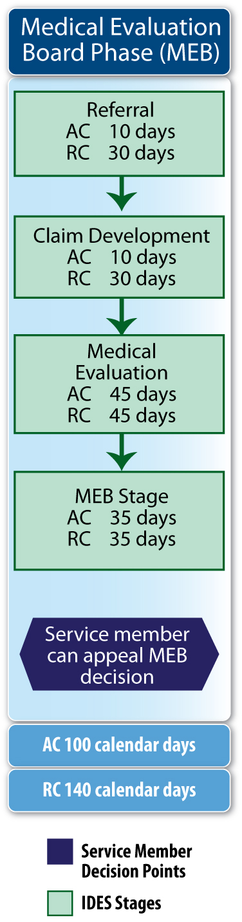
Medical Evaluation Board (MEB) Phase
The following stages occur within the MEB Phase:
Referral (DoD)
Claim Development (VA)
Medical Evaluation (VA)
MEB Stage (DoD)
REFERRAL
CLAIM DEVELOPMENT
C&P EXAM
NARSUM

Slide 14
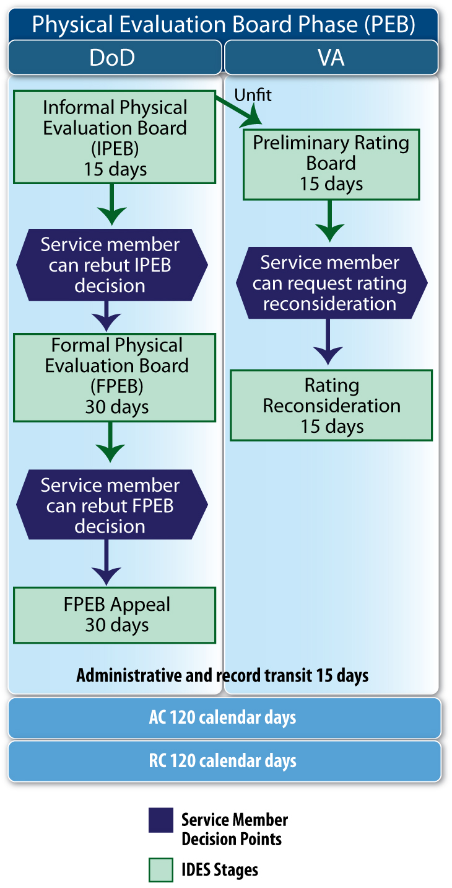
Physical Evaluation Board (PEB) Phase
Stages within the PEB Phase are:
Informal Physical Evaluation Board (IPEB)
Preliminary Rating Board (VA D-RAS)
Formal Physical Evaluation Board (FPEB)
Rating Reconsideration
FPEB Appeal
* Determines a Service member’s fitness in accordance with existing policy but does not assign disability ratings to conditions. (Fit or Unfit Determination Only)

Slide 15
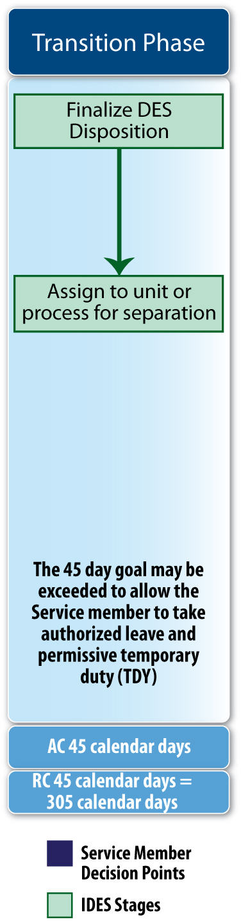
Transition Phase
PEBLO:
Informs the VA of the final PEB recommendation
Military Department:
Determines disposition; establishes separation date
Processes member for separation
Sends DD214 part 3 to MSC

Slide 16
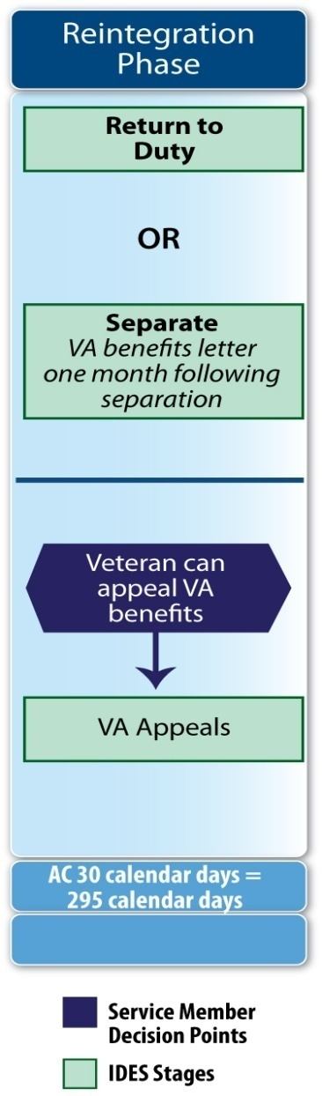
Reintegration Phase
MSC:
Coordinates VA post separation process, transfer to VA Benefits
VA DRAS:
Receives the DD214 from the Military Departments
Enters the formal rating and sends the benefits letter to the Veteran

Slide 17
Current Operational Performance as of 9 January 2011
4,384 Service members have completed the IDES since November 26, 2007
Total of 12,1307 Service members remain enrolled in the IDES
Cumulative enrollment of 17,411 Service members since November 26, 2007
Active Component Service members who completed the IDES, including pre-separation leave, averaged 322 days (exceeding goal of 295 days) but still 40 percent faster than the legacy DES and VA Claim process, which together takes a total of 540 days to complete
Reserve Component / National Guard Service members who completed the IDES averaged 312 days from entry to issuance of the VA Benefits Letter, which exceeded the IDES goal of 305 days

Slide 18





IDES Expansion
Initial Location (Nov 2007)
Walter Reed AMC
Phase I Locations (Complete JUN 2009)
Fort Belvoir
Fort Meade
Fort Stewart
Fort Polk
Fort Richardson
Fort Wainright
Fort Drum
Fort Carson
Brooke AMC
Phase II Locations (Complete 1 MAR 2010)
Fort Benning
Fort Bragg
Fort Hood
Fort Lewis
Fort Riley
Phase III Locations (Complete 4 JAN 11)
Tripler AMC
Phase III Locations
IOC 31 MAR 11
Fort Campbell
Fort Eustis
Fort Gordon
Fort Jackson
Fort Lee
Fort Rucker
IOC 30 JUN 11
Fort Sill
Fort Leonard Wood
Fort Bliss
Fort Leavenworth
Redstone
IOC 30 SEP 11
West Point
Fort Huachuca
Fort Knox
Fort Irwin
Camp Zama
Vicenza
Fort Buchanan
Landstuhl (Pending )
  IDES currently operational at 16 of 44 MTFs representing over 60 percent of all Active DES Cases
  Expect full expansion complete by end of FY2011
Key
 | Initial Locations
 | Phase I Locations
 | Phase II Locations
 | Phase III Locations
Notes:
The DES Pilot initially started in November 2007at three locations in the National Capital Region. Walter Reed Army Medical Center, the National Naval Medical Center at Bethesda, and Malcolm Grow. Based on the demonstrated capabilities of the DES Pilot, the DoD / VA Senior Oversight Committee determined that the program should be expanded to 9 additional sites as shown in Phase I. Phase I expansion began in October 2008 and will was completed in June 2009. The Phase II expansion was completed 1 MAR. Phase III (Worldwide) represents 90 percent of our caseload. Services agree to phased expansion in four deployment stages-Expansion complete by end of FY 11.
Service Expansion Plan: A phased roll-out to establish capability for 97% of DES case load by FY12; Method of exam coverage for remote CONUS and all OCONUS to be determined; Regional roll-out provides synergy (strategic communication, base support and training) and fairness for co-located locations; VA provides exams.

Slide 19
IDES Review
VISION: A seamless and transparent DES, administered jointly by DoD & VA
GOALS:
  Less complex and non-adversarial
  Faster, more consistent evaluations & compensation
  Single medical exam & single-source disability rating
  Seamless transition to Veteran status
  A continuum of care: advocacy & expectation management
Notes:
19
The Washington Post stories on conditions at Walter Reed Army Medical Center accelerated DoD’s efforts to reform the system by which wounded, ill, or injured service members are evaluated for disabilities and returned to duty or separated, compensated, and passed to the care of the VA. In response to the Washington Post series, and informed by the various commissions (congressional, presidential, and Departmental) and study groups, DoD and VA formed a Senior Oversight Committee (SOC) chaired by the Department Deputies. The SOC established targeted Lines of Action (LoAs) to address the findings and recommendations of internal studies and major commissions, such as those chaired by Senator Dole and Secretary Shalala and General Scott.
The SOC and LoAs are dedicated to improving the Departments’ disability systems which set the vision and goals you see here. The key elements of the vision and goals are based on the recommendations set forth by the Dole-Shalala commission, which embrace a new process that is joint, seamless and Service member centric. Working together, these elements are intended to prevent Service members and new Veterans from falling through the cracks as they transition from DoD into the care of VA.
After a business process reengineering effort in summer 2007, Congress authorized the Departments to execute a joint IDES program later that year through the National Defense Authorization Act (NDAA) 2008. Shortly thereafter, DoD and VA to began piloting an integrated disability evaluation process in November 2007, which implemented the Dole-Shalala recommendations within the constraints of current law. It is important to note that within the Integrated Disability Evaluation System (DES) IDES DoD determines Service member fitness for duty, and VA executes all responsibilities for evaluating and compensating Service members and Veterans.

Slide 20

QUESTIONS ????

